Slide 1
Population Growth
Dr Mohammed Shoeb
Assistant Professor
Department of Zoology
Govt. Dr WW Patankar Girl’s PG College, Durg

Slide 2
Contents
Introduction: Population
Population Dynamics
Exponential Model of Population Growth
Biotic Potential
Environmental Resistance
Carrying Capacity
Logistic Model of Population Growth
Modification of Logistic Theory
Non overlapping populations

Slide 3
Population
A population consists of a group of interbreeding organisms in an area at a particular time.
Individuals of a Population share common gene pool.
A population has several characteristics or attributes which are a function of the whole group and not of the individual. Different populations can be compared by measuring these attributes. These attributes are population density, natality, mortality, distributions.

Slide 4
Population is a dynamic entity. The Rate of change in population over a period of time is called population growth rate.
The average rate of change in the number of organisms per unit time is
Growth Rate =∆N/∆t
The average rate of change in the number of organisms per unit time per organism is
Specific Growth Rate =∆N/N∆t
If Specific growth rate is multiplied with 100 it is Percent Growth Rate=∆N/(N∆t) x100

Slide 5
Population Dynamics
Populations have characteristic pattern of increase which are called population growth forms.
Population Dynamics is studied by Mathematical Models which can be Theoretical or Simulations.
Theoretical model is based on derived equations to describe population changes and tested by comparing to real populations.
Simulations use real data and predict future behavior of populations under given conditions.

Slide 6
Predictions of models are often tested in laboratory populations.
Field studies are made to explain behavior of natural populations.

Slide 7
Exponential Growth Model of Population Growth
Exponential growth:A population shows exponential growth if there is no limitation or environmental constraint. The per capita rate of increase (the number of offspring born per individual) is maximum.
During exponential growth, the numbers increases in the geometric progression 2⁰ , 2¹ , 2² , 2³……

Slide 8
The general equation for exponential population growth is N_{t}=N₀(e^{rt})
N_{t} is the number of organisms in t generation
N₀ is the number of organisms in 0 generation
e is universal constant value 2.718
r is the intrinsic rate of natural increase and is constant for a particular population under specific environmental conditions.

Slide 9
Biotic Potential
During exponential population growth under an ideal unlimited environment, per capita rate of increase is maximum and is called the intrinsic rate of increase r.
The maximum value of r is often referred as biotic potential (or reproductive potential).
It is the maximum per capita growth rate in the absence of environmental resistance.

Slide 10
Environmental resistance
The sum total of all environmental factors that together act to limit the biotic potential of an organism from being realized is called environmental resistance.
It includes both biotic factors such as predation, competition, parasitism and abiotic factors such as drought, fire, flood etc.

Slide 11
In a closed population, r is defined as the per capita birth rate (b) minus the per capita death rate (d).
Change in population dN/ dt= (b-d)N
where, r = b – d
If birth rate is more than death rate the population will increase, r will be positive
If death rate is more than birth rate the population will decrese, r will be negative.

Slide 12
Going back to the exponential equation
N_{t}=N₀(e^{rt})
N_{t}/N₀=e^{rt}
ln N_{t} – ln N₀ = r t
When resources (food and space) in a habitat are unlimited, all members of a species have the ability to grow exponentially.
The population size that increases exponentially at a constant rate, results in a J-shaped growth curve when population size (N) is plotted over time (t).

Slide 13
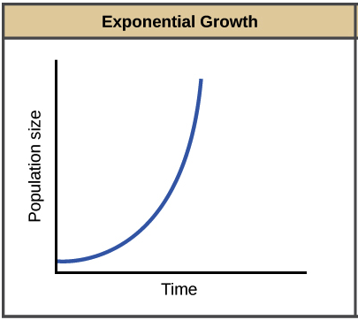
Exponential Growth Plot

Slide 14
Carrying capacity
How ever under natural environmental conditions a number of abiotic conditions and competition from other species does not let population growth to exceed an upper size limit.
This limit is called Carrying capacity of the environment for that population. It is determined by the available food and space.

Slide 15
Logistic Growth Model
The Logistic Equation was devised by Verhulst in 1838 to describe population growth with an upper limit.
The Logistic equation assumes that the intrinsic rate of natural increase (r) is progressively reduced as population size increase towards the carrying capacity (K).
The intrinsic rate of natural increase (r) is reduced in relation to proportion of remaining resources.

Slide 16
The logistic growth equation is
N_{t}=N₀(e^{r})(K-N/K)^{t}
Using differential calculus the logistic equation becomes
dN/dt= rN(K-N/K)

Slide 17
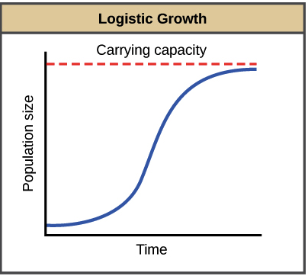
Logistic Growth Curve

Slide 18
Modifications of Logistic theory
Logistic theory is based on certain assumptions:
Environment is constant so that K and r does not change
There is no time lags in response of the population to change in density
Growth is continuous
Age structure does not change

Slide 19
But these assumptions are not met in natural or laboratory conditions.
Certain modifications are made in the to make the logistic theory more reasonable biologically.
These include:
Inclusion of Time Lag in response of population to change in density
Fluctuations in carrying capacity
Survival and reproduction of an individual is affected by natural calamities and accidental deaths

Slide 20
Discontinuous growth of some populations which grow in discrete steps with little or no overlap between successive generations.

Slide 21
Non overlapping Populations
Populations in which adult die after one breeding season have non overlapping generations.
All individuals represent single generation.
These include some univoltine insects and annual plants.

Slide 22
The growth of biological populations with non overlapping generations can exhibit a remarkable spectrum of dynamical behavior with
Stable equilibrium points
Stable cyclic oscillations between 2 population points
Stable cycles with 4, 8, 16, . . . points, through to a chaotic regime in which (depending on the initial population value) cycles of any period occur
An aperiodic but bounded population fluctuation

Slide 23
The growth of non-overlapping populations can be described by nonlinear difference equations, which assume that mortality and recruitment are instantaneous and discrete. However, in reality, mortality and recruitment are more continuous.

Slide 24
The population growth rate is affected by a number of factors including
Mortality: A stable population occurs when mortality is high and the reproductive period is relatively short.
Recruitment: The population growth rate is dependent on recruitment.
Lifespan: The population growth rate is dependent on the duration of the lifespan.
Reproductive period: The population growth rate is dependent on the timing of the reproductive period.

Slide 25
Discreet time models are appropriate for populations with non over lapping generations.
For non overlapping populations
Basic reproductive rate (R₀=∑lx mx)
    lx= proportion of original cohort surviving to each age
    mx= fecundity
    R₀ considers birth of new individual
R₀ converts initial population size N₀ to new size N_{T} one generation later.
N_{T}= N_{0.} R₀
Intrinsic growth rate is average rate of increase per individual
r≈ ln R₀/Tc

Slide 26
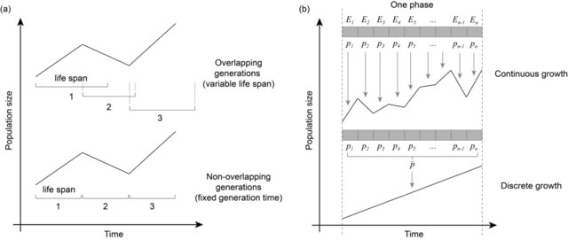
A schematic comparison of demographic growth settings.
Although the overlapping and non-overlapping generation models may have similar population dynamics,
the events within these dynamics are different. The main difference between the two models

Slide 27
References
Ecology and Environment by PD Sharma
Ecology by Odum
Biological adaptation under fluctuating selection Ming Liu, Dustin R. Rubenstein,Wei-Chung Liu, Sheng-Feng Shen

